Slide 1


CivicBridge
Trustworthy Civic AI

Slide 2


CivicBridge
Trustworthy Civic AI
What if using government services didn't feel like navigating a maze?

Slide 3

CivicBridge
Trustworthy Civic AI
What if AI isn't an unpredictable black box, but a system that can be trusted and verified?

Slide 4
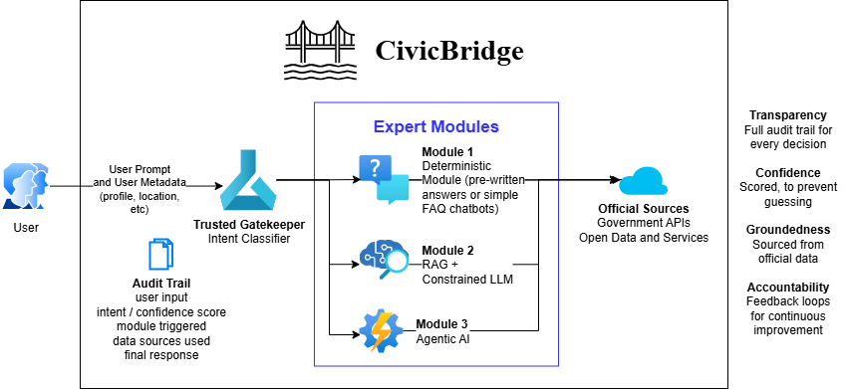
CivicBridge
Trustworthy Civic AI

Slide 5
CivicBridge
Trustworthy Civic AI

Slide 6
CivicBridge
Trustworthy Civic AI

Slide 7
CivicBridge
Trustworthy Civic AI

Slide 8
CivicBridge
Trustworthy Civic AI

Slide 9
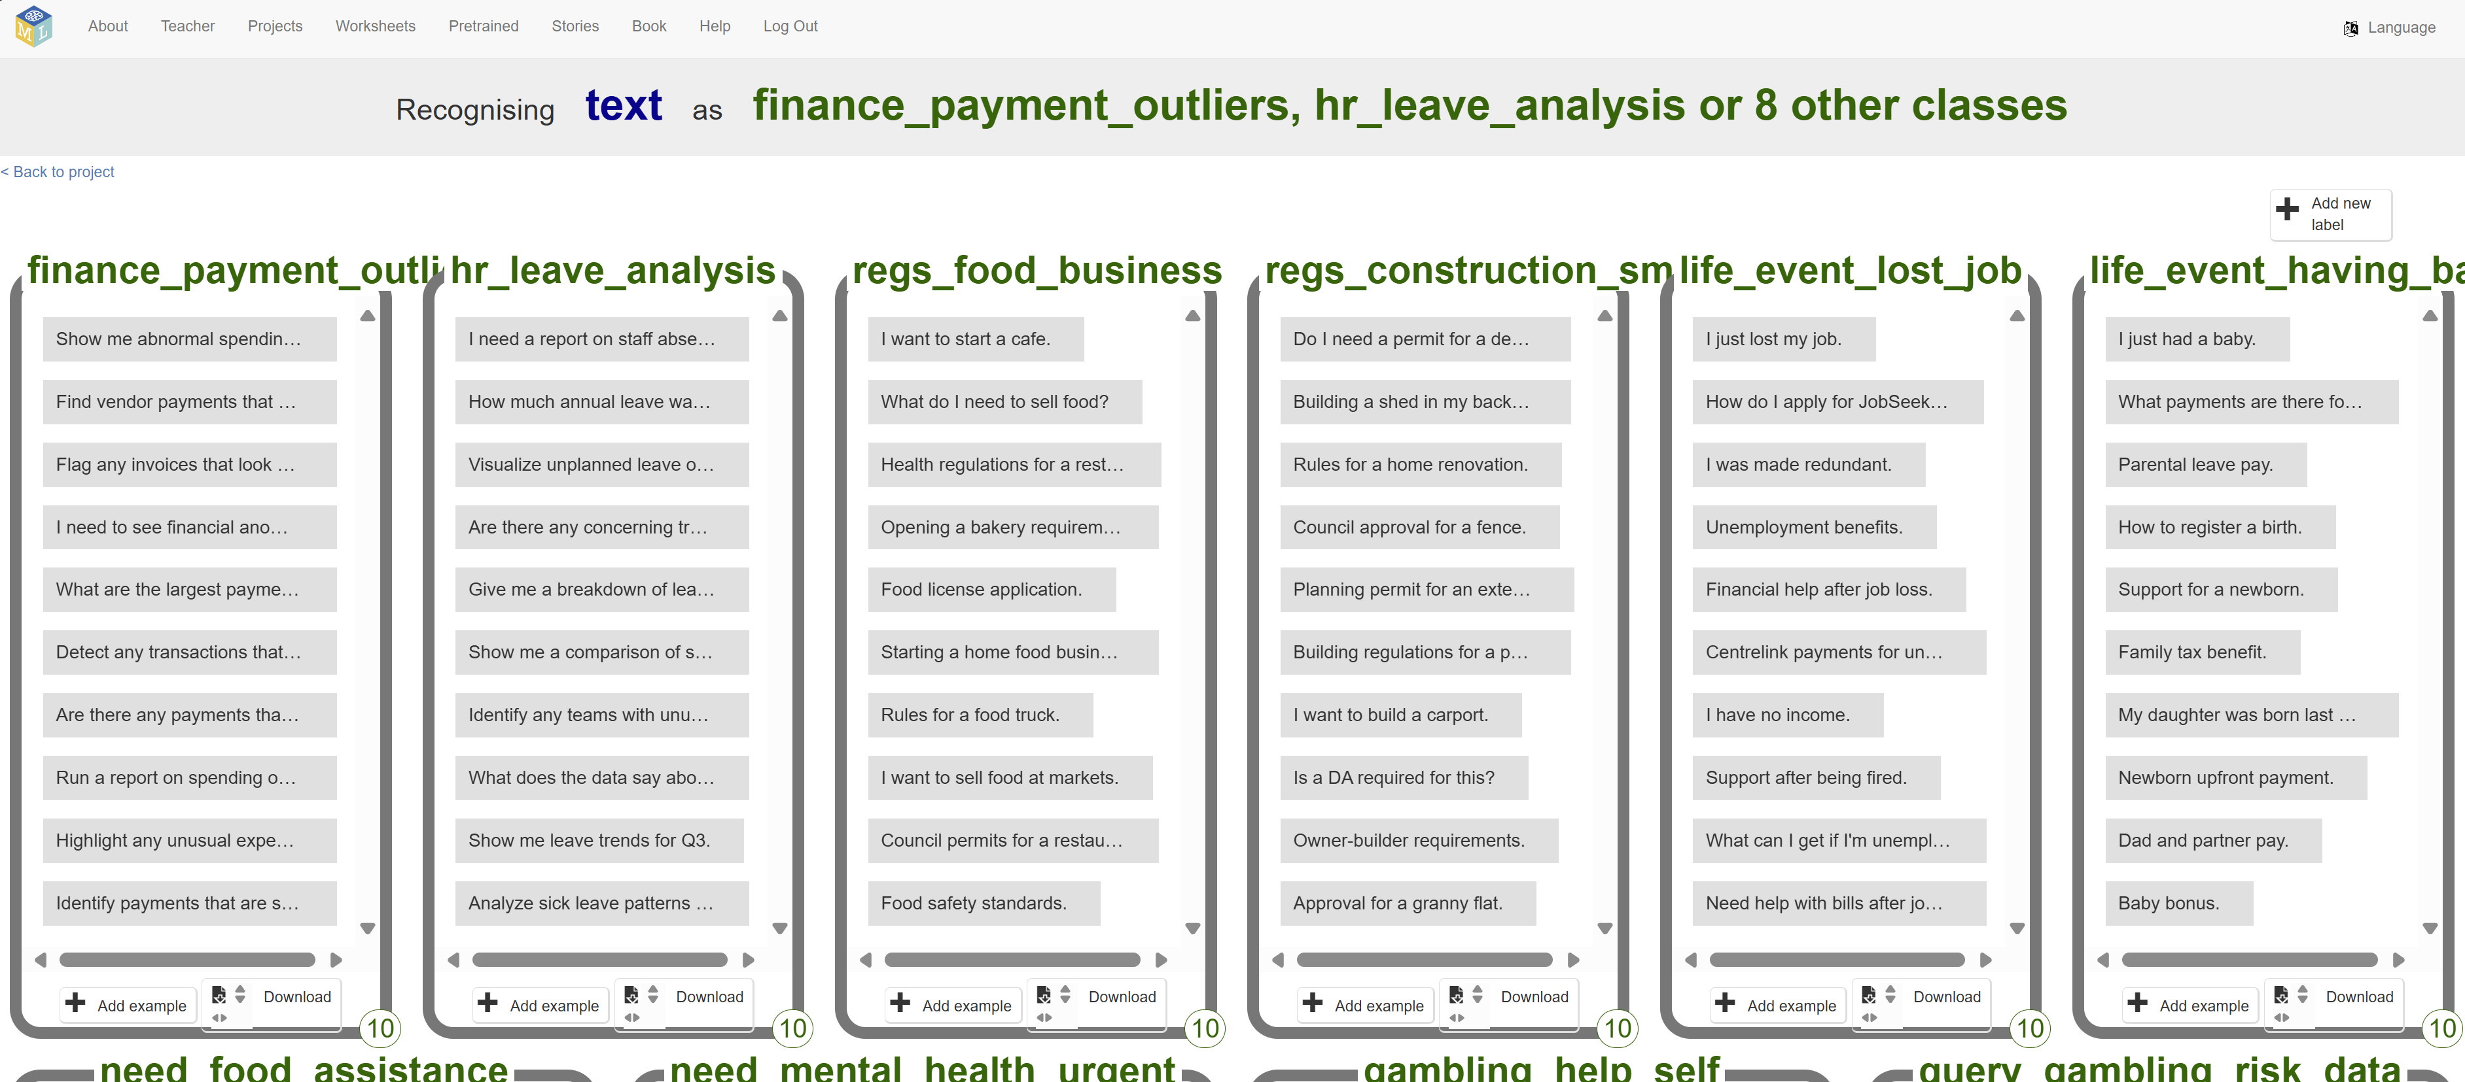


CivicBridge
Trustworthy Civic AI

Slide 10
CivicBridge
Trustworthy Civic AI
[ Demo Video on Scratch ]

Slide 11
CivicBridge
Trustworthy Civic AI
Full Auditability: Every decision is fully traceable to its source.
Modular & Adaptable: Routes each query to its ideal, safe processing module or subsystem.
One Core, Endless Uses: Extensible for a wide variety of services, regulations, and community support.
Ethical & Inclusive: Simple, accessible design built for public trust.

Slide 12
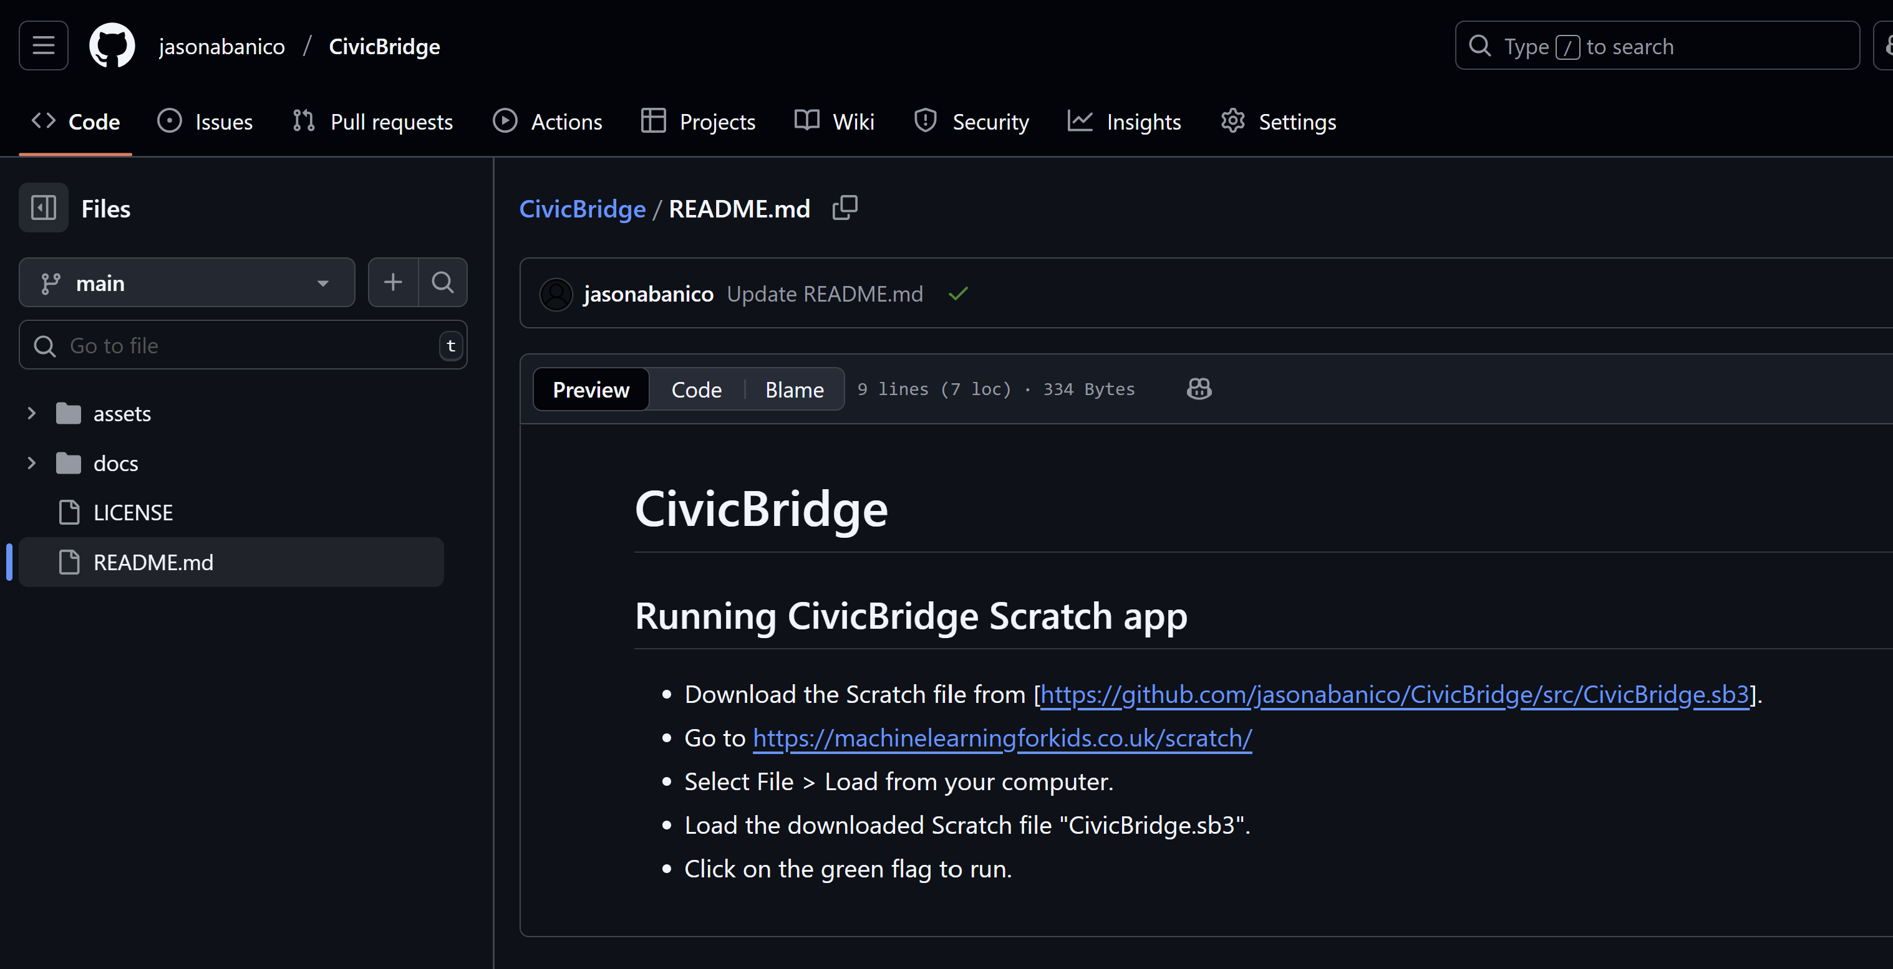
CivicBridge
Trustworthy Civic AI
Play with the CivicBridge demo ML model using our Scratch file!
Download from github.com/jasonabanico/CivicBridge
NOTE: The ML model is hosted on a free service. If the demo does not work, it may be due to high usage.
Please contact the Banico Family team if there are issues and we’ll set up a duplicate model.

